Slide 1



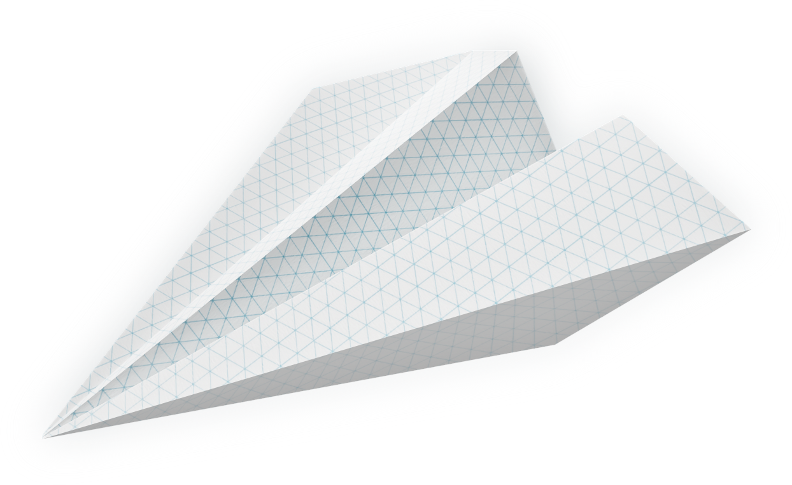
IoT-Based Healthcare Predictive Analytics
Team members:
Durjoy Chatterjee, Riyanka Das, Shrutakeerti Datta, Adrija Ray Choudhury

Slide 2
Contents:
Introduction
Problem Identification
Literature Survey
Objective
Method to generate predictive data of patients
Target Beneficiaries
Business prospect and Future scope
Conclusion
Video illustration and decision tree
References

Slide 3


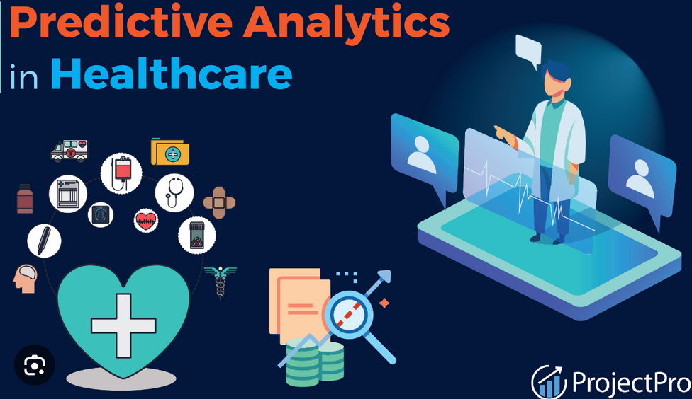
INTRODUCTION
IoT (Internet of Things)-based healthcare predictive analytics involves using IoT devices and sensors to collect real-time data from patients, healthcare equipment, and other sources.
IoT data-driven predictive model for patient health deterioration involves several steps, including data collection, preprocessing, feature engineering, model training, and prediction
This data is then analyzed using advanced analytics and machine learning techniques to predict outcomes, detect anomalies, and provide valuable insights for proactive healthcare management.

Slide 4
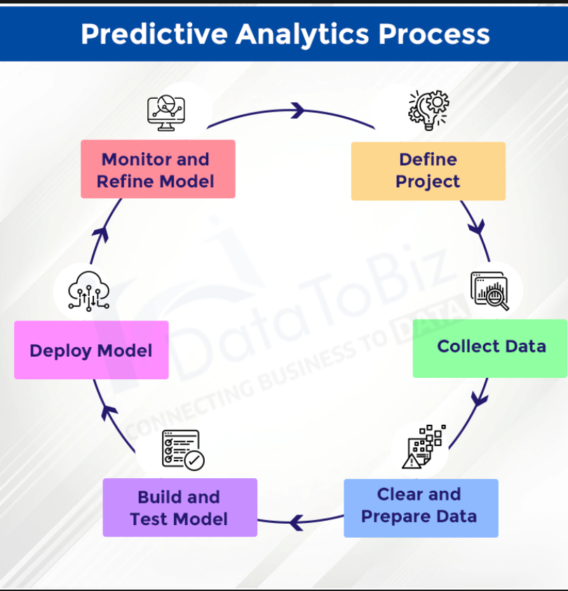
FLOWCHART ON IOT BASED PREDICTIVE ANALYSIS USING ML

Slide 5
PROBLEM
IDENTIFICATION
In the traditional methods ,we used to see there were limited in the small cities
The efficiency of the machines were much low during the past
Humans can do mistake at the time of prediction, there are many cases where the patient got affected due to wrong prediction.
The speed of prediction is really slow by humans.
Due to unavailability of incorrect data even the patients had to face death

Slide 6
LITERATURE
SURVEY
Patents
Key Findings
Remarks
1) Systems and methods for management of clinical queues
Inventor:-Dean Nida,Michael Brown-Hayes,James Chung,Carolyn Espinoza,Michael Emerson,John Larson,Jennifer Tschirpke
Healthcare provider, the clinical queue comprising a list of individuals prioritized for healthcare intervention based on the plurality of risk scores, receiving feedback from the client device regarding the clinical queue, and updating at least one predictive model of the plurality of predictive models based on the feedback.
We have used BIG DATA to analyze the fastest way to predict data , the decision tree can is used to bring out the refined way of data analytics in this case
2)Intelligent integration, analysis, and presentation of notifications in mobile health systems
Inventor-Eric Brill,Philip N. Fibiger
Patient information may be received from an electronic medical record system. Integrated decision processing can integrate two or more of the alarm indication, the models of clinical alert events, the patient context, and the information from the electronic medical record system.
The predictive data analysis has done a very widened job according to health experts ,this project can be a epitome of success in that field
3)Quantitative medical imaging reporting
Inventor-Mary E. Buckler,Xiaonan Ma,
Lawrence MARTELL,,Andrew J. Buckler
Advanced reporting systems based on ontology development for quantitative imaging biomarkers, information modeling to integrate heterogeneous data types relevant to quantitative medical analysis, and a knowledge representation framework for their statistical validation.
Lastly,we have used the minimal resources to build this module,not something really expensive

Slide 7
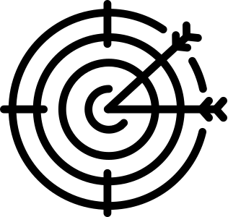

OBJECTIVE:
1 .IOT enables healthcare professionals to
be more watchful and connect with the
patients proactively.
2.Data collected from
IoT devices can help physicians identify
the best treatment process for the
patients and reach the expected outcome.
3. It utilises electronic patient records and
streamlines processes with the aim of
improving the quality of peoples’ lives by
reducing health risks and improving their
well being.

Slide 8
Methods to Generate Predictive Data Of Patients
This project contains a data set that we generated from a hospital about the health conditions of the regular outdoor patients.
The classification method to analyse the data prediction is trained here.
We have trained the model the model learns the relationships between the features and the target variable based on historical data patterns.
We have predicted and extract data generated by the model relationship
We have analyzed the post predicted data and compared it to the actual outcome.

Slide 9

TARGET BENEFICIARIES:
Predictive analytics in the healthcare industry, powered by IoT (Internet of Things), offers numerous benefits and opportunities to improve patient care, optimize resource allocation, and enhance operational efficiency
Early Disease Detection and Intervention
Remote Patient Monitoring
Optimized Resource Utilization
Chronic Disease Management
Clinical Trials and Drug Development
Public Health Surveillance

Slide 10
Business Prospect and Future Scope
1.Remote patient monitoring.
2. Public health survillance.
3.product-Omron HBF-306 body fat analyzer.
4. Health monitoring system.

Slide 11
CONCLUSION
The module will create a standalone opportunity for the healthcare industry to emerge
This project will be able to detect an increased amount of diseases which requires enormous amount of clinical assets.
Therefore growth in Deep Learning and IoT are figuring out their way over the modern world through integrating various technologies in the field of medical healthcare.
IoT achieved immense popularity because of its data acquiring and visualizing property through sensing the objects and and communication with devices, through wireless networks.
Data collected from these devices are used for different tasks like disease classification ,designing, patient monitoring and so on.

Slide 12
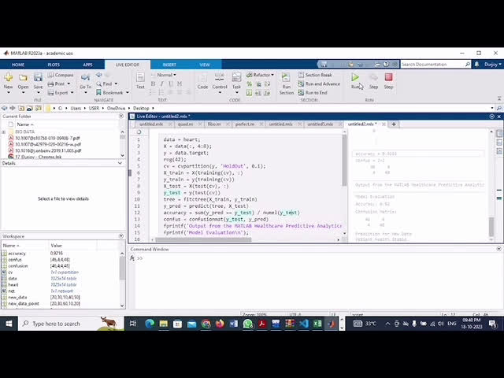
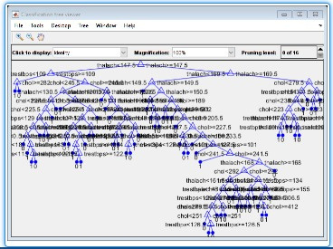
Video Illustration:-
Decision Tree Analysis:-

Slide 13
REFERENCES:
Raghupathi, W., Raghupathi, V.: Big data analytics in healthcare: promise and potential. Health Inf. Sci. Syst. 2(1), 3 (2014)
Baro, E., Degoul, S., Beuscart, R., Chazard, E.: Toward a literature-driven definition of big data in healthcare. BioMed Res. Int. (2015)
Khan, M.A. An IoT Framework for Heart Disease Prediction Based on MDCNN Classifier. IEEE Access 2020, 8, 34717–34727
Awang, A. An Analytical Model to Minimize the Latency in Healthcare Internet-of-Things in Fog Computing Environment. PLoS ONE 2019, 14, e0224934. [Google Scholar] [CrossRef][Green Version]
Roy, D.S.; Shafi, J.; Wozniak, M.; Ijaz, M.F. A Novel Blockchain-Based Healthcare System Design and Performance Benchmarking on a Multi-Hosted Testbed
Samuel, O.W.; Asogbon, G.M.; Sangaiah, A.K.; Fang, P.; Li, G. An Integrated Decision Support System Based on ANN and Fuzzy_AHP for Heart Failure Risk Prediction. Expert Syst. Appl. 2017, 68, 163–172. [Google Scholar] [CrossRef]

